Slide 1

Introduction to Simulink

Slide 2

Simulink applications

Slide 3
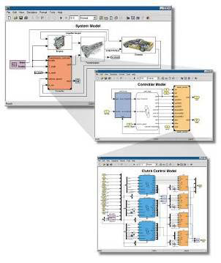
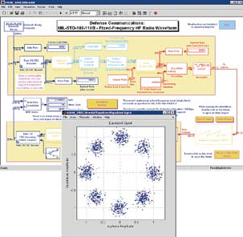
Simulink
Simulink is a software package for modeling, simulating, and analyzing dynamical systems
Block diagram editing
Nonlinear simulation
Hybrid (continuous and discrete) models
Asynchronous (non-uniform sampling) simulation
Fully integrated with MATLAB, MATLAB toolboxes and blocksets

Slide 4
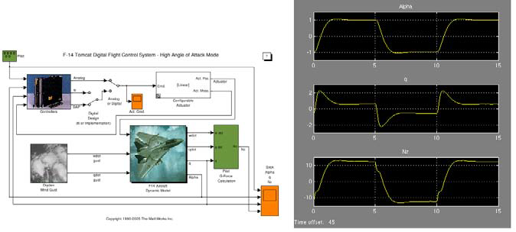
Accurately design, implement, and test: Control systems
Signal Processing systems
Communications systems
Embedded systems
Physical systems
other Dynamical systems

Slide 5
Model based design with Simulink
Modeling and simulation
Multidomain Dynamic Systems
Nonlinear Systems
Continuous-time , Discrete-time, Multi-Rate systems
Plant and Controller Design
Rapidly model what-if scenarios
Communicate design ideas
Embody performance specifications
Select/Optimize control architecture and parameters
Implementation
Automatic code generation
Rapid prototyping for HIL, SIL
Verification and validation

Slide 6
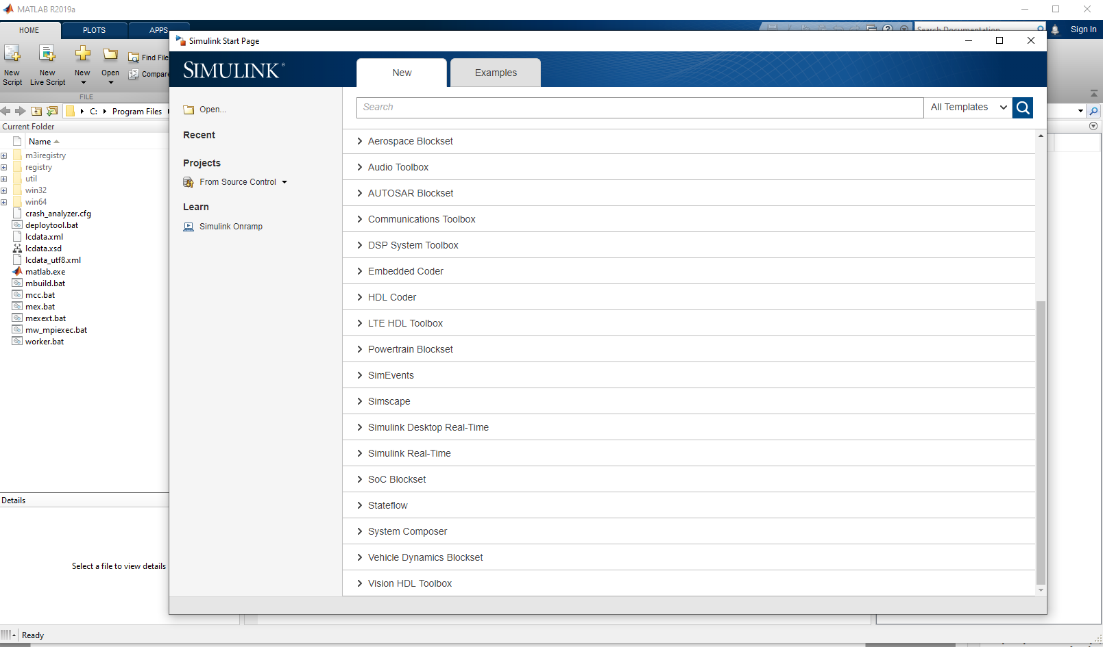
Launching Simulink

Slide 7
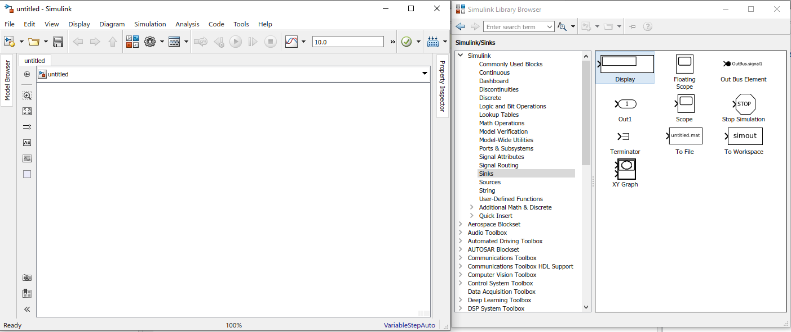
Simulink Library Browser

Slide 8
Getting help
Context sensitive help
Simulink documentation

Slide 9
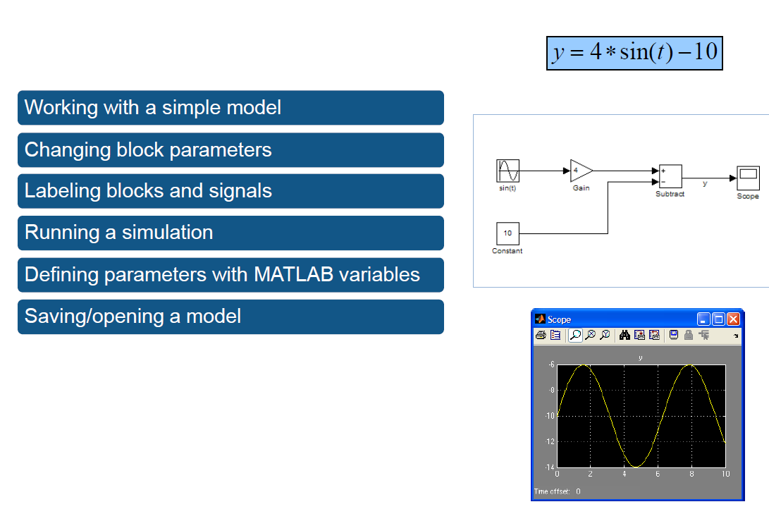
Demo

Slide 10
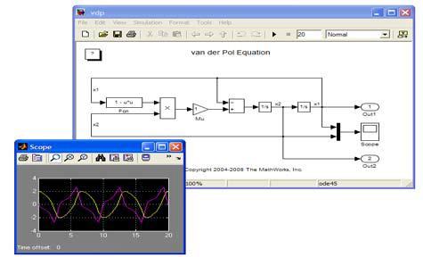

How Simulink works
Engine provides variable-step and fixed-step ODE solvers
Block Diagram representation of dynamic systems
Blocks define governing equations
Signals are propagated between blocks over time

Slide 11
Simulink solver
Solver? Determines solution at current time step
Determines the next simulation time step
Solver options:
Fixed-Step
  Ode1
  Ode2
  Ode3
  Ode4
  Ode5
  Ode8
Variable-Step
    Ode45
    Ode23
    Ode113
    Ode15s
    Ode23s
    Ode23t
    Ode23tb

Slide 12
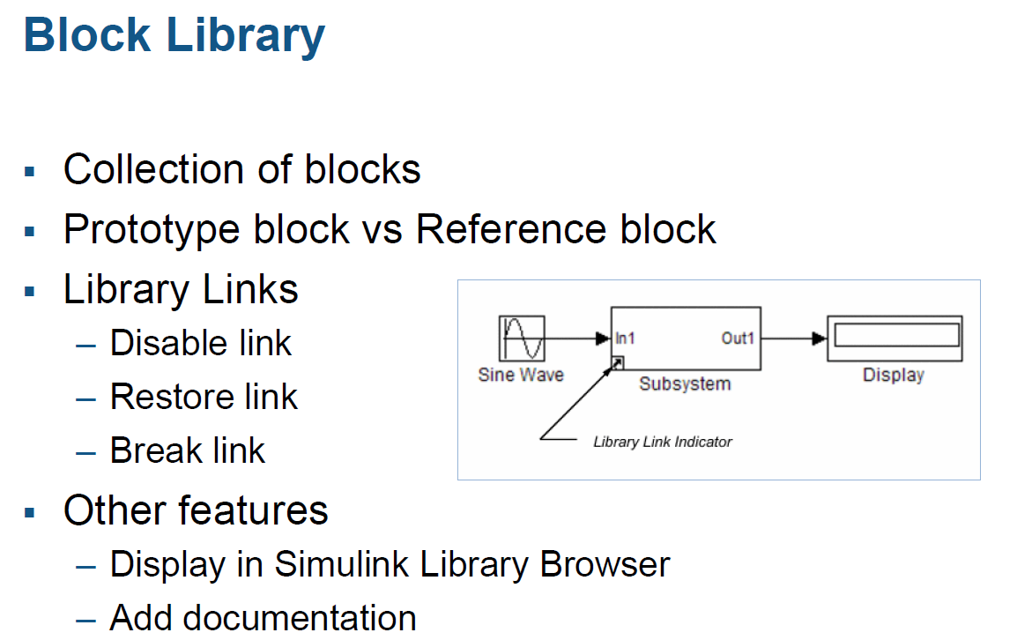

Slide 14
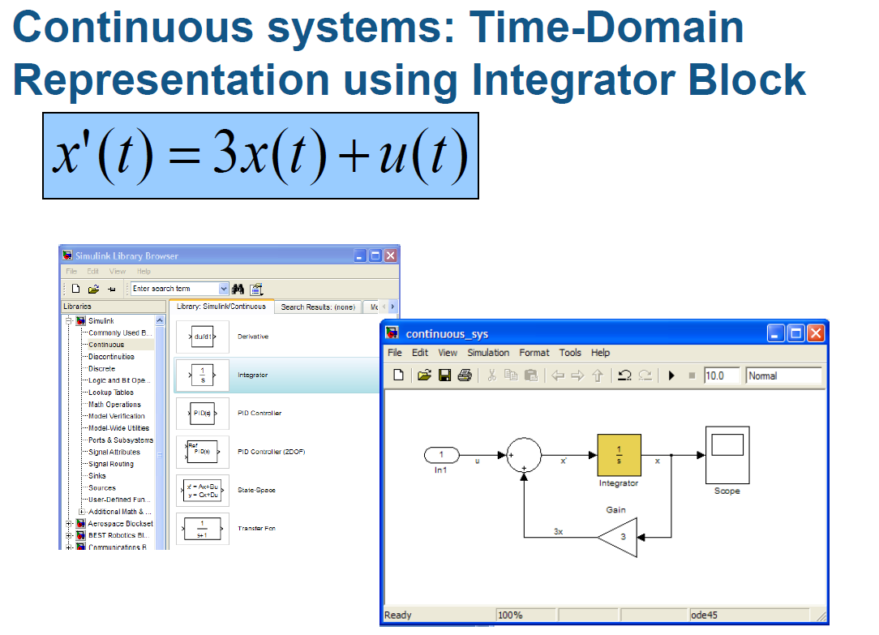

Slide 15
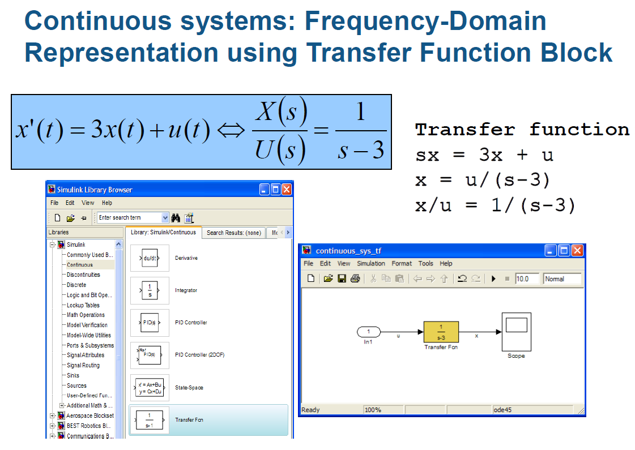

Slide 16
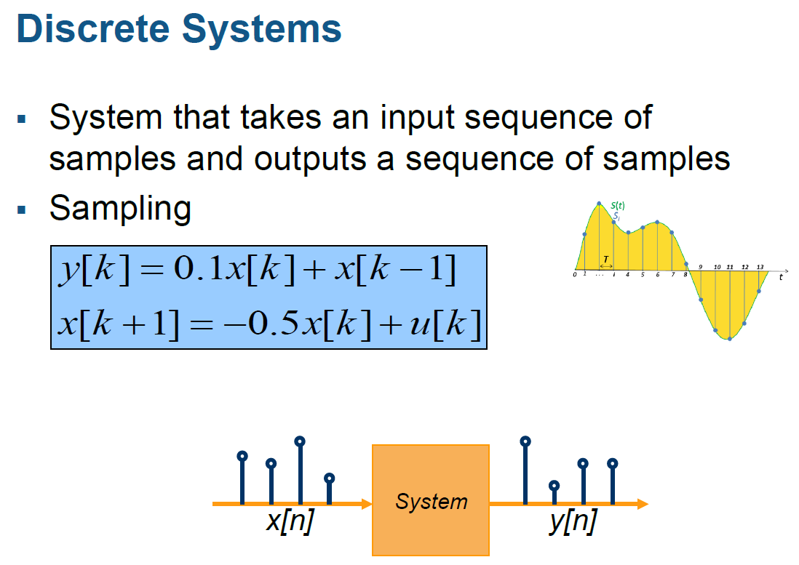

Slide 17
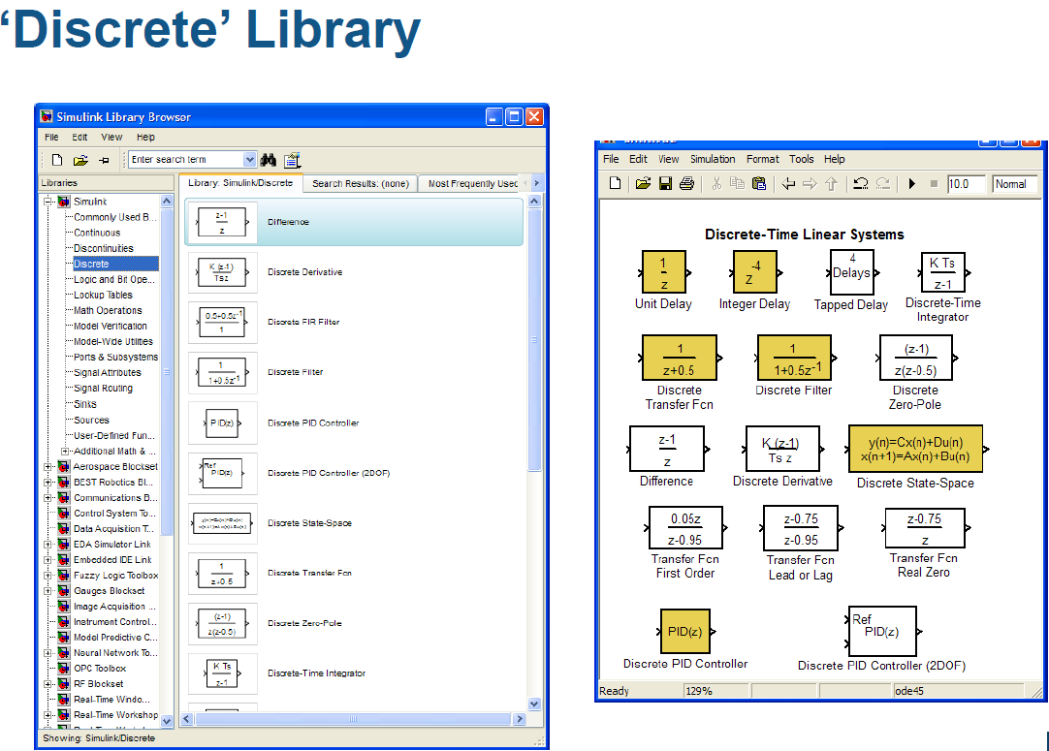

Slide 18
